Slide 1
NBA Prediction
With Machine Learning
Fateh Luqman and Jason Boyer

Slide 2
TOPIC/QUESTION TO ANSWER
Question to answer:
Based on the statistics of NBA Champions from past seasons, can we predict the winner of the current NBA Season (2021-22) using the teams current stats?
We chose this subject because of our interest in sports and in particular NBA. Additionally, the use of statistics in sports has been evolving for years. For example, a basic box score with minutes played, points, rebounds and a few other stats was the standard, but now with improved technology performance can be broken down to individual players on individuals plays, which can show which kind of plays and where on the court a player has the most success scoring. Even though our analysis will not go this deep, winning a championship goes beyond the number of wins and losses a team has in the regular season. So we wanted to use a set of advance stats to see if we could predict a winner.

Slide 3
PROJECT OUTLINE
01
03
02
04
SOURCE DATA
ML MODEL
https://www.basketball-reference.com/
https://stathead.com/basketball/
Log Regression
Random Forest
DATABASE
PRESENTATION
PostgreSQL
Flask API
Tableau

Slide 4
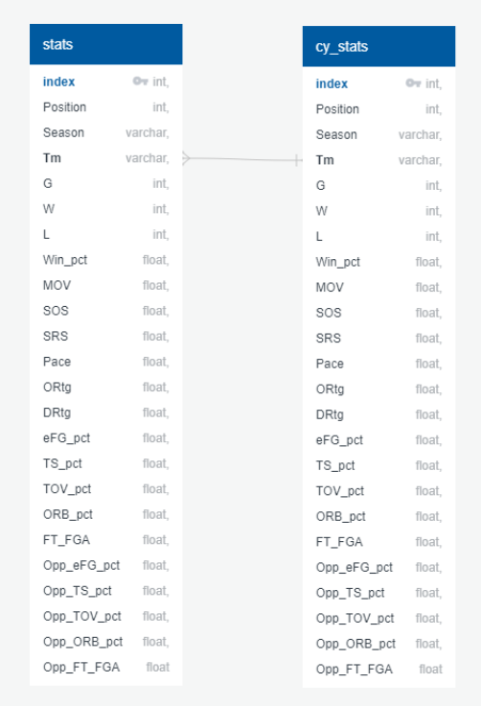
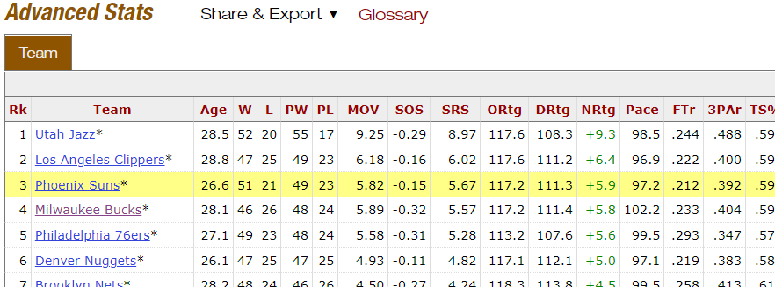
SOURCE/DATABASE
Data cleaning/preprocessing done in Python
Both datasets are loaded into PostgreSQL from file ‘database.ipynb’
Database connection accomplished using SQLAlchemy

Slide 5
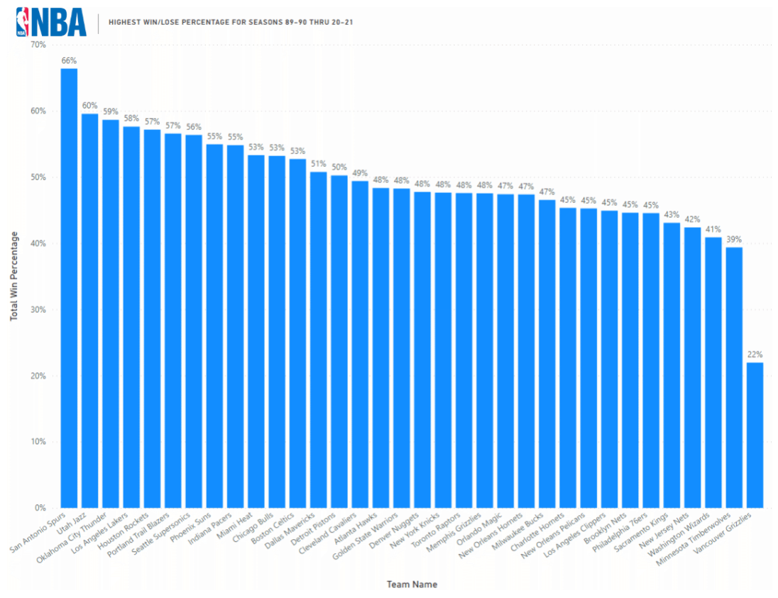
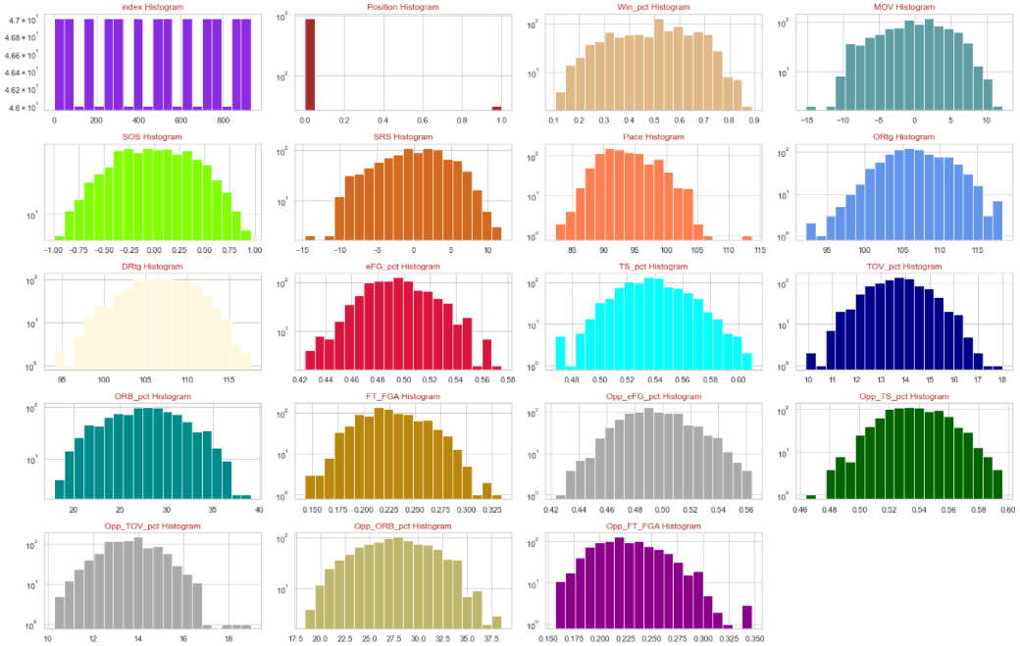
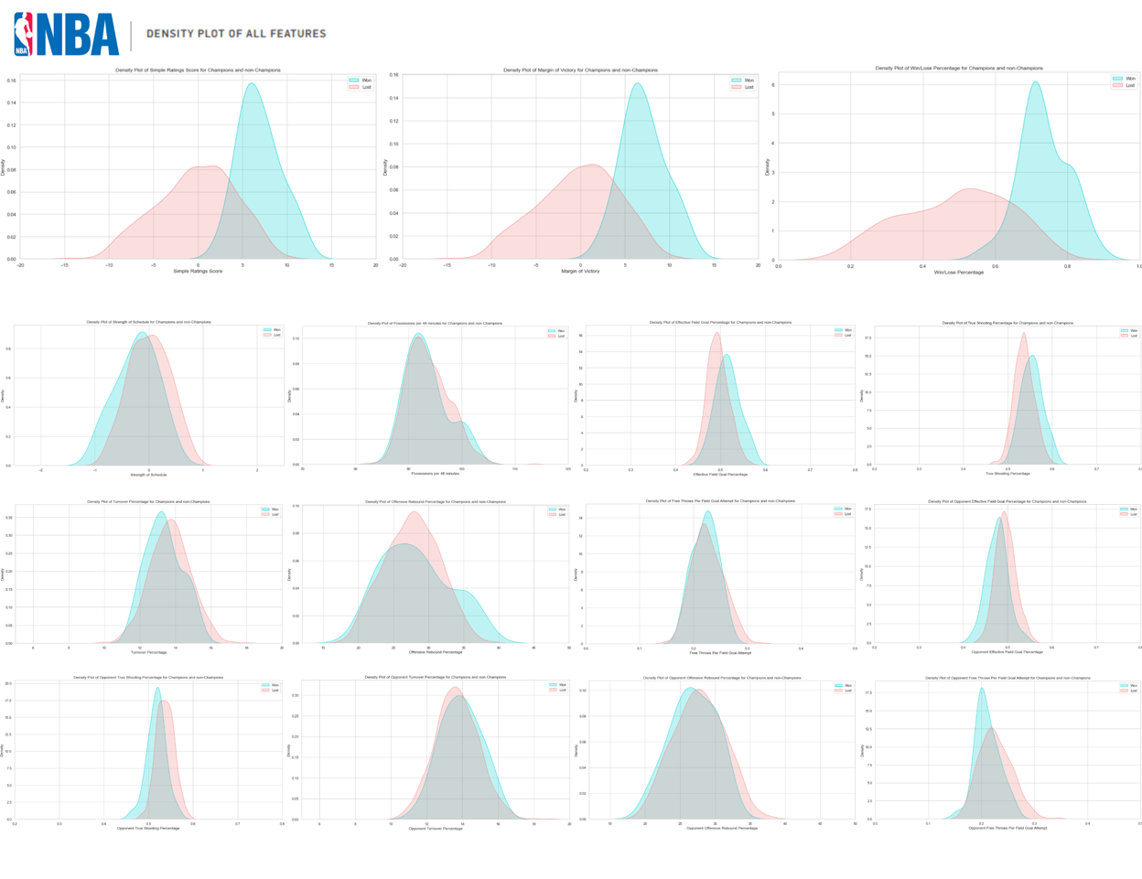
EXPLORING THE DATA
PRE-MODEL
Dataset explored using Power BI before modeling to look for any distinguishing features
FEATURE EXPLORATION
Features explored using histograms, density plots and other techniques

Slide 6


ML MODELS
01
Logistic Regression
Random Forest Classification

Slide 7
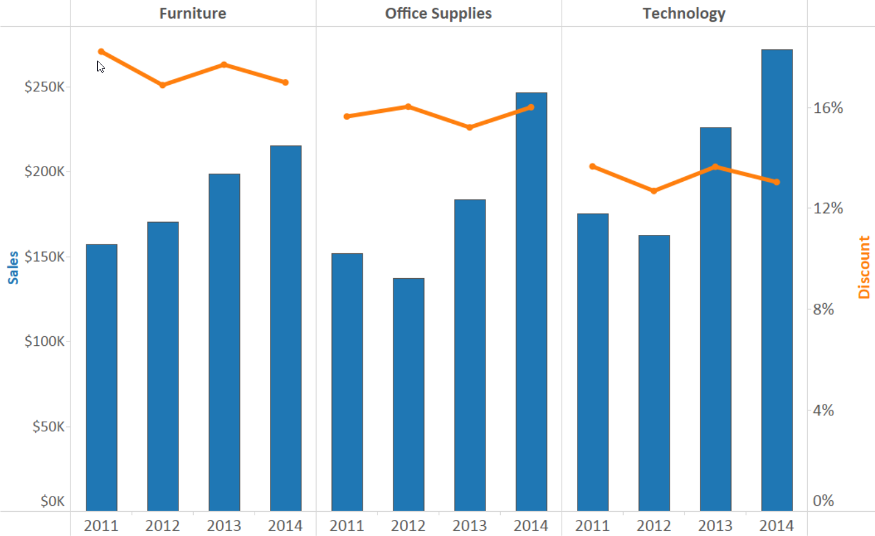
PRESENTATION
WEBSITE
NBA PREDICTION
Presentation will feature an interactive Tableau chart and a outcome of the model prediction.
Interactive Tableau Chart
Here you give a brief intro of the topic you want to talk about. For example, you can talk about Mercury
Model Prediction
NBA CHAMPS!!!

